Slide 1
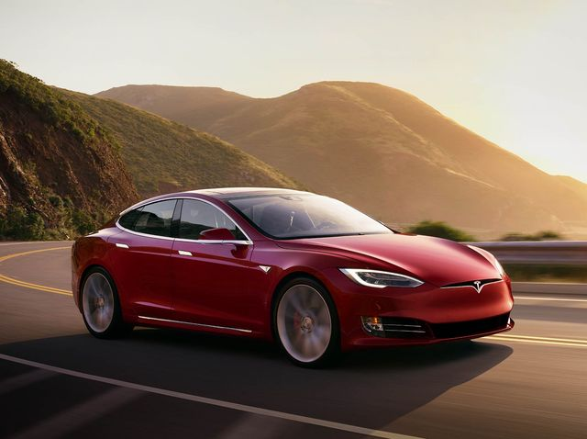
Car Rental
Presented by: Sidney Watts, Luke Monington, Nicholas Bartnik, Mandeep Singh

Slide 2
Our Scenario
Database for car rental business
Several locations
Several car classifications
A person can be an employee, customer, or both
Pricing based on classification and promotion

Slide 3
Our Solution
6 Tables
Car
Car Classification
Promotion
Rental Transaction
Person
Store Location
10 Assumptions
A person can be an employee, a customer, or both
A car can be rented many times

Slide 4
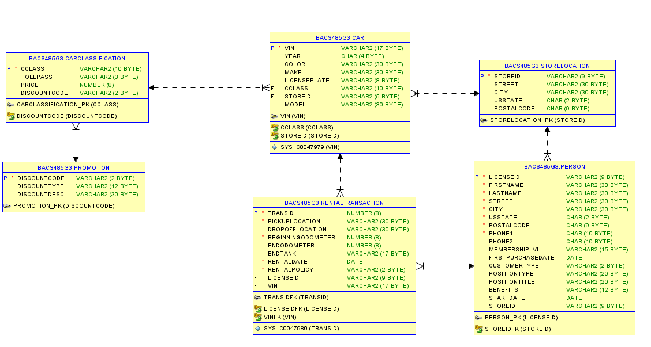
Relational Model

Slide 5
Table Creation Order
PROMOTION
STORELOCATION
CARCLASSIFICATION
CAR
PERSON
RENTALTRANSACTION

Slide 6
Problems We Had
Divide and conquer
Concurrency issues
Table creation order
Adding Foreign Keys
Alter table commands vs. constraints in table creation
ORA-00001 “unique constraint violated”
Subtype/Supertype Situation
Limited knowledge of object oriented programming in Oracle
Combined Employee and Customer into the Person table, allowed nulls

Slide 7
Queries We are Proud of
SELECT MIN (PRICE)
FROM CARCLASSIFICATION
WHERE PRICE IN
(SELECT PRICE
FROM RENTALTRANSACTION, CARCLASSIFICATION, CAR
WHERE RENTALTRANSACTION.VIN = CAR.VIN
AND CAR.CCLASS = CARCLASSIFICATION.CCLASS
AND DROPOFFLOCATION IS NOT NULL);

Slide 8
Continued
SELECT MAKE, MODEL, CAR.VIN
FROM CAR
WHERE CAR.VIN NOT IN
(SELECT CAR.VIN
FROM CAR, RENTALTRANSACTION
WHERE CAR.VIN = RENTALTRANSACTION.VIN);

Slide 9
Database Demo

Slide 10
Questions?

Slide 11
Thank You!

